Slide 1

Cookies and Sessions
How cookies work
Attributes of a cookie
Sessions

Slide 2

See Also
https://en.wikipedia.org/wiki/HTTP_cookie
http://stackoverflow.com/questions/1700390/best-option-for-session-management-in-java
Notes:
Some additional information on concurrency

Slide 3

Cookies
HTTP requests are isolated.
The server needs a way to track state between requests (like for authentication).
The server asks the client to store cookies.
The browser then sends down the cookies with every request.
Cookies have a “maximum age”.
Session cookies have a max age of -1, and they live until the browser is shut down.
Streams of bytes … two ways (into your program and out of your program)
Disks, consoles, sockets, keyboards, printers
Know how to talk streams and you can talk to anything
Initialization (constructor) is different. Use is the same.

Slide 4
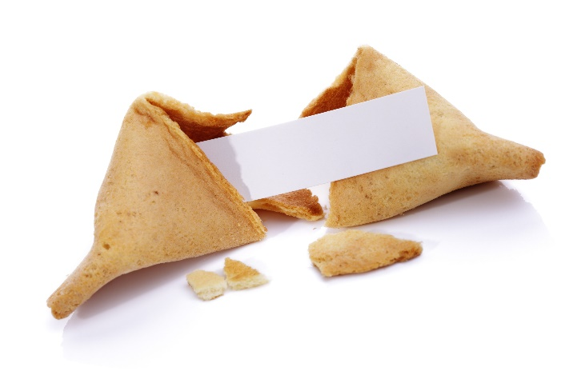
Server Sends “Set-Cookie”
GET /index.html HTTP1.0
User-Agent: Mozilla/4.0
Accept-Language: en-us
HTTP/1.1 200 OK
Content-Type: text/html
Set-Cookie: flavor=chocolate
<html><body>Hello</body></html>
GET /other.html HTTP1.0
User-Agent: Mozilla/4.0
Cookie: flavor=chocolate
flavor=chocolate
GET /hello HTTP1.0
User-Agent: Mozilla/4.0
Cookie: flavor=chocolate
Streams of bytes … two ways (into your program and out of your program)
Disks, consoles, sockets, keyboards, printers
Know how to talk streams and you can talk to anything
Initialization (constructor) is different. Use is the same.

Slide 5
Parts of a Cookie
Set-Cookie:
flavor=chocolate;
Path=/code/sub;
Domain=my.com;
Expires=Sat, 04-Jun-2016 18:57:28 GMT;
Max-Age=360;
Comment=testing;
HttpOnly;
Secure
Name and Value
Who gets the cookie (within the domain)
Who gets the cookie (like books.my.com and pets.my.com)
When the browser should delete
The new (best) way, but <IE9 does not support it
Info for the user to decide if OK
Cannot be accessed by javascript
Only sent to “https” (secure) URLs
Streams of bytes … two ways (into your program and out of your program)
Disks, consoles, sockets, keyboards, printers
Know how to talk streams and you can talk to anything
Initialization (constructor) is different. Use is the same.

Slide 6
Cookie Playground
@Override
protected void doGet( HttpServletRequest request, HttpServletResponse response) throws ServletException, IOException
{
response.setContentType("text/html");
PrintWriter pw = response.getWriter();
pw.println("Cookies:<br>");
Cookie [] cs = request.getCookies();
if(cs!=null) {
for(Cookie c : cs) {
pw.println(":"+c.getName()+":"+c.getValue()+":<br>");
}
}
String cname = request.getParameter("name");
String cvalue = request.getParameter("value");
String cage = request.getParameter("age");
String cpath = request.getParameter("path");
if(cname!=null && cvalue!=null) {
pw.println("<p>Setting cookie :"+cname+":"+cvalue+":");
Cookie c = new Cookie(cname, cvalue);
if(cpath!=null) c.setPath(cpath);
if(cage!=null) c.setMaxAge(Integer.parseInt(cage));
response.addCookie(c);
}
}
// SimpleServlet
ServletHandler servletHandler =
new ServletHandler();
servletHandler.addServletWithMapping(
SimpleServlet.class,
"/code/*");
Streams of bytes … two ways (into your program and out of your program)
Disks, consoles, sockets, keyboards, printers
Know how to talk streams and you can talk to anything
Initialization (constructor) is different. Use is the same.

Slide 7
Live Demonstration
Streams of bytes … two ways (into your program and out of your program)
Disks, consoles, sockets, keyboards, printers
Know how to talk streams and you can talk to anything
Initialization (constructor) is different. Use is the same.

Slide 8

Sessions
The server can maintain POJO session objects automatically.
Tomcat and Jetty use the cookie “JSESSIONID” for sessions.
Your code can write attributes to the session object and read them back in later requests from the client.
The session object lives in the JVM on the server. Only the session id is passed around in the cookie.
Streams of bytes … two ways (into your program and out of your program)
Disks, consoles, sockets, keyboards, printers
Know how to talk streams and you can talk to anything
Initialization (constructor) is different. Use is the same.

Slide 9
Enabling Sessions in Jetty
public static void main(String[] args) throws Exception {
// For static files
ResourceHandler staticFilesHandler = new ResourceHandler();
String [] welcomeFiles = {"index.html"};
staticFilesHandler.setWelcomeFiles(welcomeFiles);
staticFilesHandler.setResourceBase("webroot");
// SimpleServlet
ServletHandler servletHandler = new ServletHandler();
servletHandler.addServletWithMapping(SimpleServlet.class,"/code/*");
// Sessions
SessionHandler sessionHandler = new SessionHandler();
// Container of handlers
HandlerList handlers = new HandlerList();
handlers.addHandler(sessionHandler);
handlers.addHandler(staticFilesHandler);
handlers.addHandler(servletHandler);
Server server = new Server(80);
server.setHandler(handlers);
server.start();
}
}
Streams of bytes … two ways (into your program and out of your program)
Disks, consoles, sockets, keyboards, printers
Know how to talk streams and you can talk to anything
Initialization (constructor) is different. Use is the same.

Slide 10
Using Sessions
HttpSession session = request.getSession(false);
HttpSession session = request.getSession(true);
session.invalidate();
session.setAttribute("username", "Marco Polo");
session.getAttribute("username");
Streams of bytes … two ways (into your program and out of your program)
Disks, consoles, sockets, keyboards, printers
Know how to talk streams and you can talk to anything
Initialization (constructor) is different. Use is the same.

Slide 11
Session Playground
@Override
protected void doGet(... request, ... response) ...
{
response.setContentType("text/html");
PrintWriter pw = response.getWriter();
String uname = request.getParameter("name");
String command = request.getParameter("command");
if(command!=null && command.equals("login")) {
HttpSession session = request.getSession(true);
session.setAttribute("username", uname);
pw.println("You logged in.");
return;
}
// ...
// ...
HttpSession session = request.getSession(false);
if(session==null) {
pw.println("You must login.");
return;
}
if(command!=null && command.equals("logout")) {
session.invalidate();
pw.println("You are logged out.");
return;
}
pw.println("Welcome "+
session.getAttribute("username")+
" how may I serve you?");
}
Streams of bytes … two ways (into your program and out of your program)
Disks, consoles, sockets, keyboards, printers
Know how to talk streams and you can talk to anything
Initialization (constructor) is different. Use is the same.

Slide 12
Live Demonstration
Streams of bytes … two ways (into your program and out of your program)
Disks, consoles, sockets, keyboards, printers
Know how to talk streams and you can talk to anything
Initialization (constructor) is different. Use is the same.

Slide 13

Tinkering
Type in the CookiePlayground and the SessionPlayground. Make two servlets in the same server.
Use your browser to tinker with the playgrounds.

